Slide 1
COMP 490
Project Proposal
Chat JTDAN
Aya Samaha
Tigran Manukyan
Nora Qizi
Joseph Clifford
Dylan Tran

Slide 2
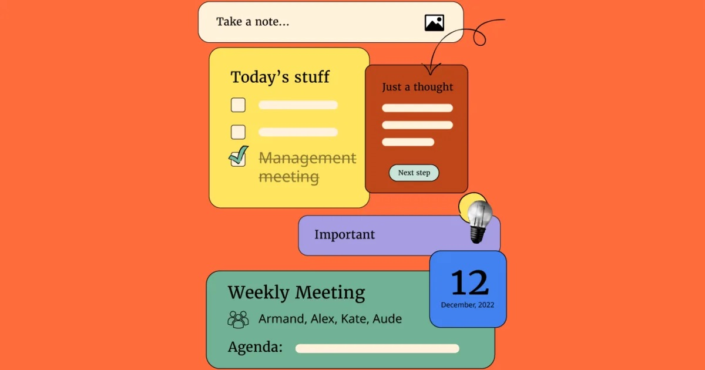
Agenda
Team Members
Project Summary
Project Importance
Project Impact
Project Approach
Questions

Slide 3
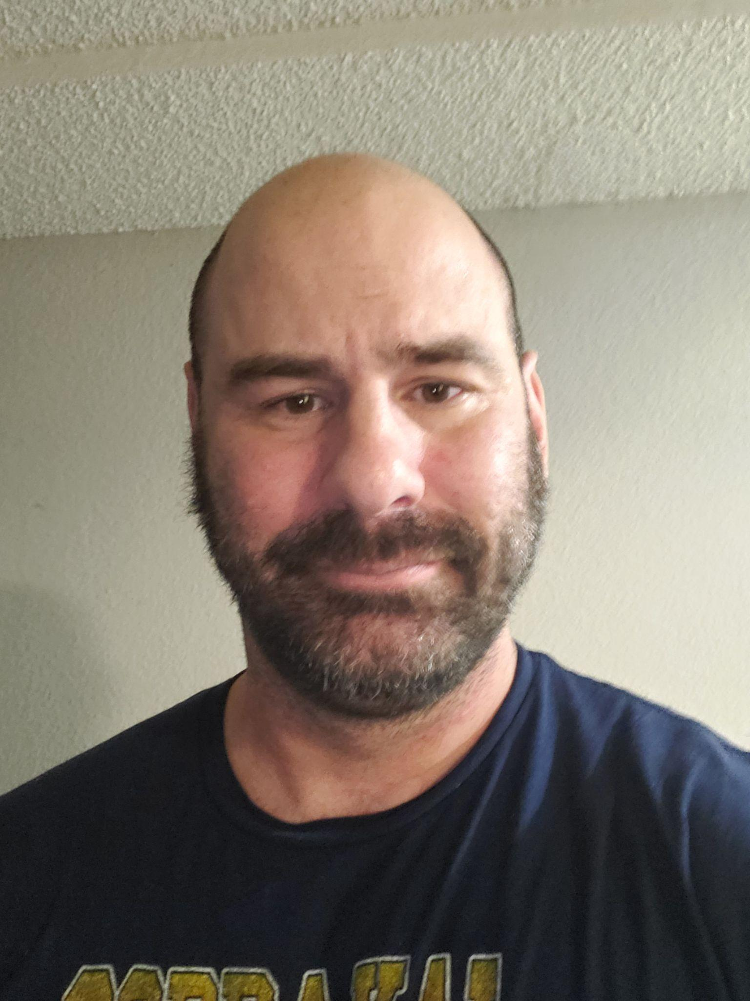
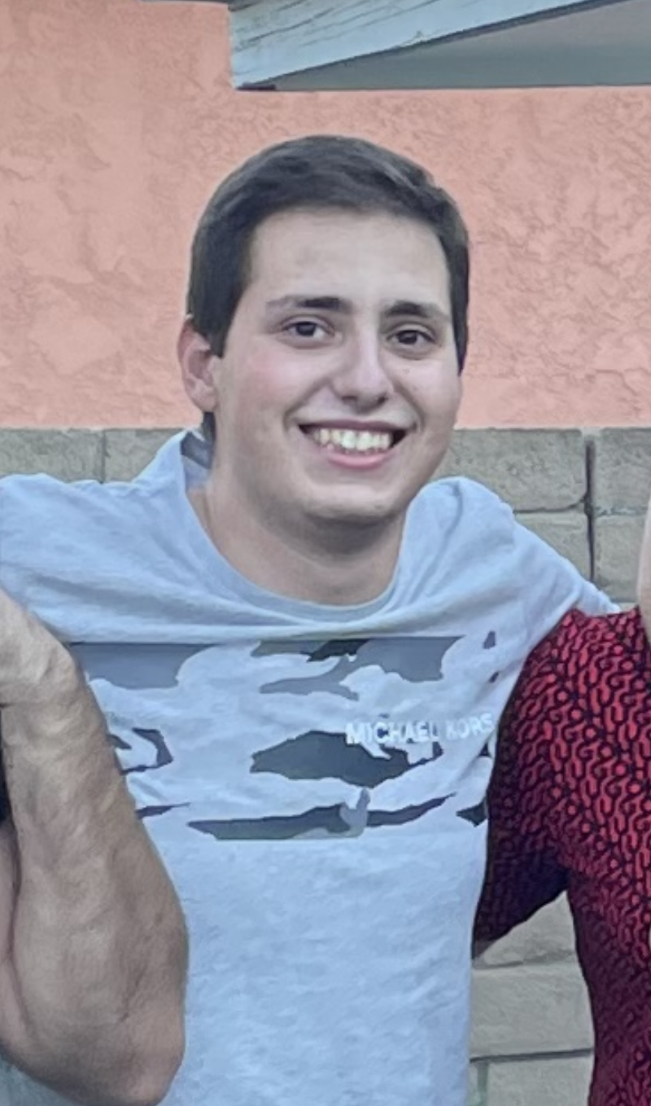


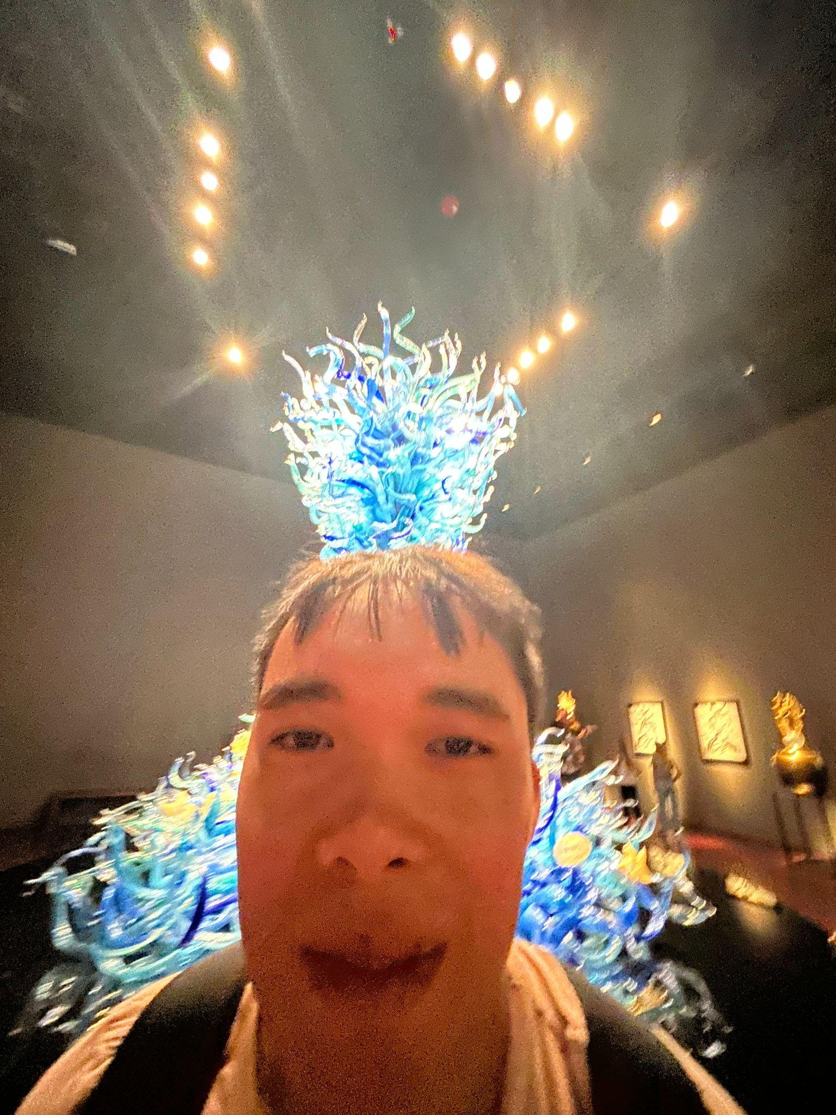
Team Members:
Joseph Clifford
Tigran Manukyan
Nora Qizi
Aya Samaha
Dylan Tran
Team Lead:
Aya Samaha
Backend:
Tigran Manukyan
Joseph Clifford
Frontend:
Nora Qizi
Dylan Tran

Slide 4

Project Summary
Creating a phone app Android to be specific that’s accessible by everyone. That is designed to help you achieve your goals even if the goal is as small as going to the grocery store.
Goal Each goal is going to have subtasks you can create to help you towards the goal.
Schedule your meetings and event.
Motivation - you’ll feel motivated once you see how close you are to achieving your “goal”. Thus making one more inspired to keep track of their own progress and more organized overall.
Can be used to set reminders for upcoming events, deadlines, and appointments
Ability to record, manage, and track new and completed tasks

Slide 5
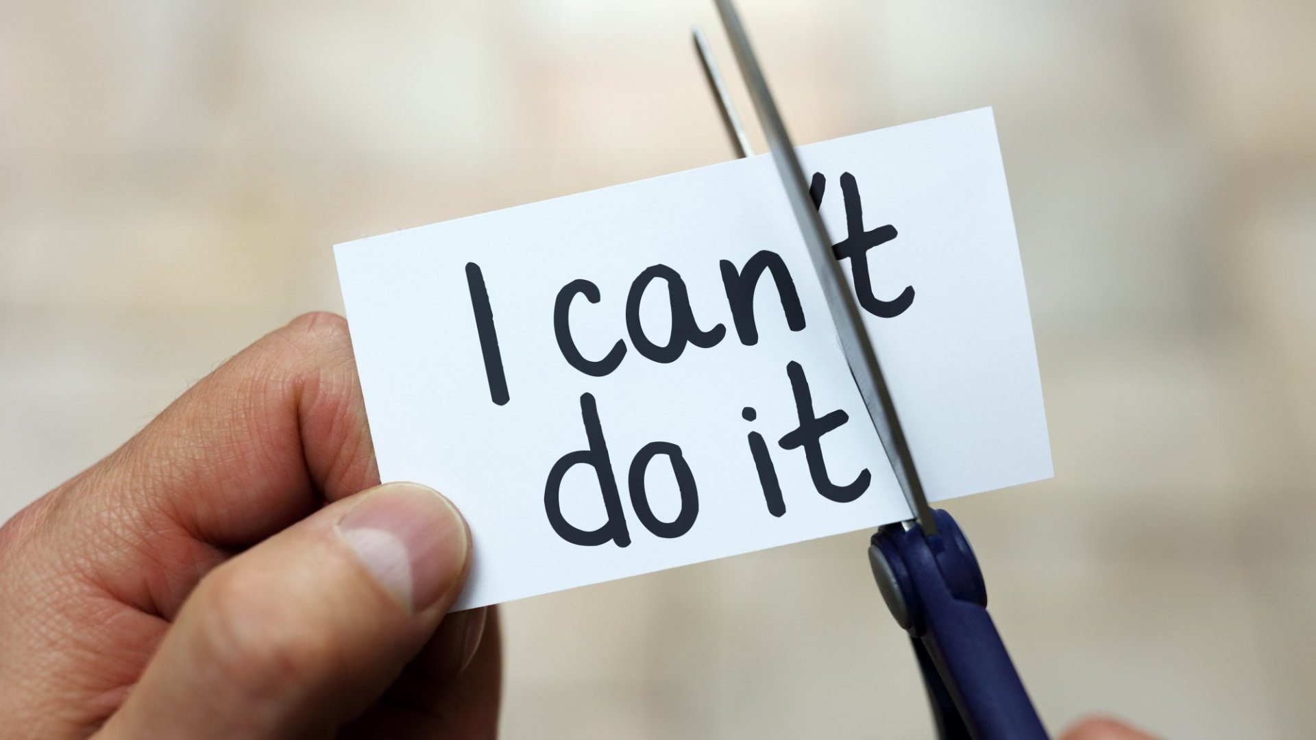

Project Importance
Background:
We’ve all had trouble keeping up with goals we set for ourselves:
Remembering all the things we want to do
Keeping order of what is important
Life can be overall stressful
Difficulty staying motivated without goals in front of you
Need attainable objectives
The Project:
An app to help keep track of goals
A schedule and time frame for completion of tasks
Assistance with scheduling days given entered events and goals

Slide 6

Project Impact
Day to Day:
Intuitive Layout
Subdividing Goals into Discrete Tasks.
Organizing Tasks So One Leads into Another
Tasks are placed in successive order in case you can’t remember what to do next
Over Time:
Smaller Attainable Goals Combine To Become Tasks of Larger Goals
Organized in a Manner Where One Goal Leads to Another
Increased Productivity
Time management

Slide 7
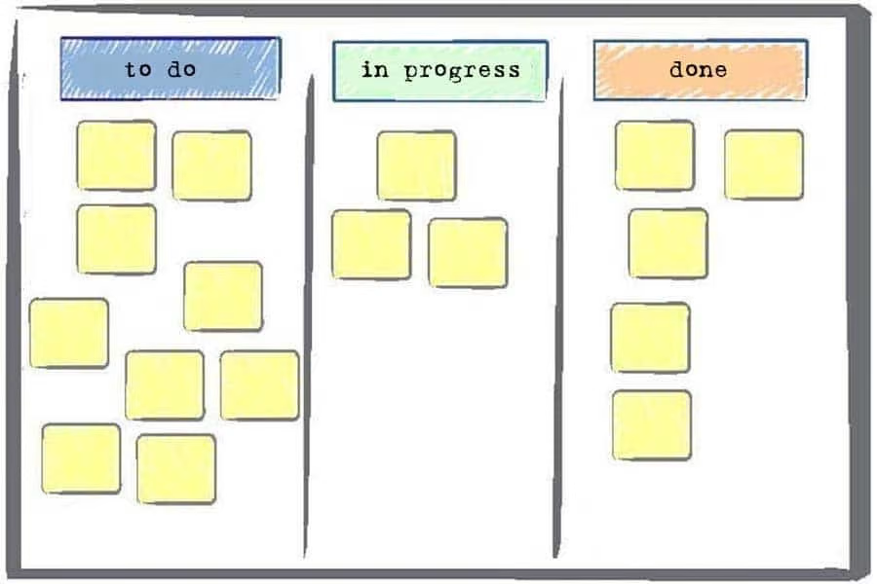
Project Approach
Strategy:
Begin with a focused concept
Build around core concept with additional features as we go
Develop focused set of user stories at the start and add more along the way
Use Jira task board to keep track of user story completion
Method:
Split frontend and backend duties between teammates
Keep code consistent via a shared GitHub repository
Programming:
Language: Java
IDE: Android Studio
MySQL

Slide 8
Experience
Team Experience
Java:
• Dylan • Joseph • Tigran • Nora •Aya
Jira:
• Dylan • Tigran • Nora • Aya
Android Studio:
• Joseph •
GitHub:
Dylan • Joseph • Tigran • Nora • Aya
MySQL:
• Joseph •

Slide 9







Any Questions?

